Slide 1
Regulation of blood sugar and gas concentrations

Slide 2
What are we doing today?
Blood sugar levels are maintained by controlling of sugar uptake, its storage and release by cells and use in metabolism; these processes involve the hormones of the pancreas and adrenal glands (SU)
Gas concentrations are controlled by balancing the intake of oxygen and the removal of carbon dioxide via the lungs, through the actions of the medulla oblongata and the autonomic nervous system (SU)
Feedback systems – positive and negative (SU)
Homeostatic processes involve nerves and hormones in maintaining the body’s internal environment within tolerance limits through the control of metabolism and physiological and behavioural activities (SU)
Select, use and/or construct appropriate representations, including diagrams, models and flow charts, to communicate conceptual understanding, solve problems and make predictions.(SIS)
Synthetic hormones may be developed to control or treat endocrine dysfunction, including diabetes mellitus to improve the quality of life for individuals (SHE)

Slide 3

Negative feedback
Response reduces or eliminates the stimulus that causes it

Slide 4
Why are the levels of glucose in your blood so important?
We need glucose for cellular respiration
Glucose is transported around your body to cells in the blood
HOWEVER you don’t spend all your time eating to keep blood sugar high. Instead the level of sugar in the blood is controlled by hormones

Slide 5
Blood Sugar
Keywords
Glucose
Glycogen
Insulin
Glucagon
A sugar used in respiration to make energy
A storage substance made of glucose, it is stored in the liver.
A hormone (chemical messenger) it tells your body to change glucose into glycogen. It is made by the pancreas.
A hormone that tells your liver to change glycogen back into glucose. Also made by the pancreas..

Slide 6
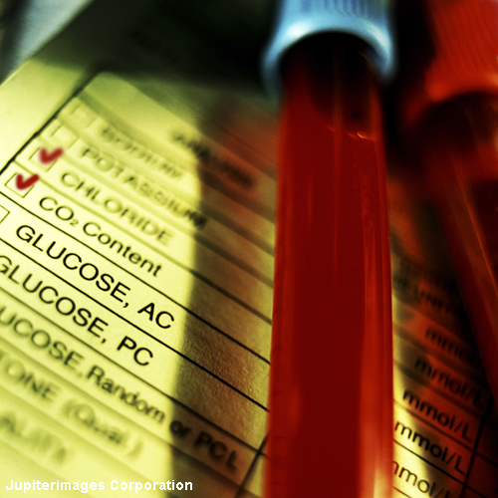
What is blood glucose?
Glucose is a type of sugar used by the body to provide energy through cellular respiration.
Glucose + Oxygen -> Carbon Dioxide + Water + Energy
Sometimes there is too much glucose in the blood, and sometimes there is not enough.
What affects the level of blood glucose?
Eating and glycogen stores causes blood glucose levels to rise.
Vigorous exercise and general metabolic activity causes blood glucose levels to fall.
Notes:
Photo credit: © 2007 Jupiterimages Corporation

Slide 7


Controlling blood glucose
Between meals, blood glucose levels are topped up from stored deposits in the liver and muscles.
After a meal, blood glucose rises but quickly returns to normal. Where does the excess go? Why not leave it in the blood?
Excess glucose makes the blood plasma and tissue fluid around cells too concentrated. This can severely damage cells, for example, causing crenation in red blood cells.
However, low blood sugar levels can be equally as dangerous, as it can make cells swell up and burst. This is called lysis.
Notes:
Teacher notes
See the ‘Movement In and Out of Cells’ for more information about how osmosis affects animal cells.

Slide 8
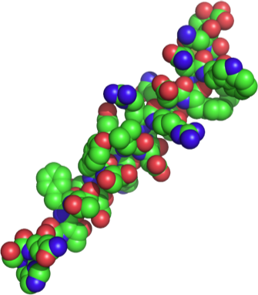
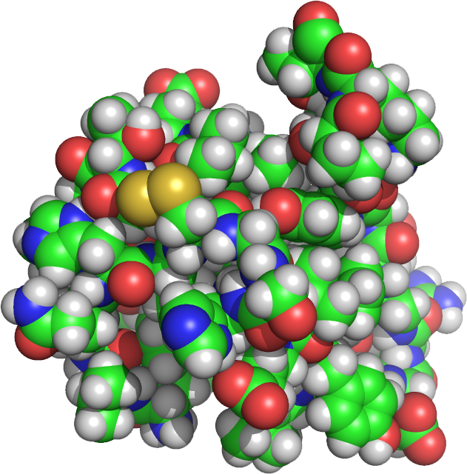
Control of Blood Glucose
The endocrine portion of the pancreas (the α and β cells of the islets of Langerhans) produces the hormones insulin and glucagon.
These hormones act antagonistically to maintain blood glucose at a steady state through negative feedback.
Regulation of blood glucose to within narrow limits allows energy to be available to cells as needed.
Glucagon promotes an increase in blood glucose by stimulating the breakdown of glycogen and the synthesis of glucose from amino acids.
Insulin promotes a decrease in blood glucose by promoting cellular uptake of glucose glycogen synthesis in the liver.

Slide 9
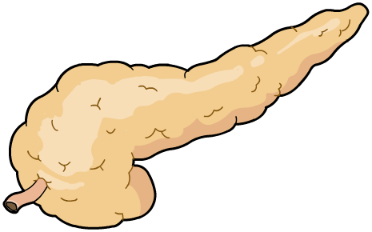
The pancreas and blood glucose
Blood glucose levels are monitored and controlled by the pancreas.
pancreas
The pancreas produces and releases different hormones depending on the blood glucose level.
Insulin is released when blood glucose levels are high – the liver stores excess glucose as glycogen.
Glucagon is released when blood glucose levels are low – the liver converts stored glycogen into glucose and releases it into the blood.
Notes:
Teacher notes
See the GCSE Science (Biology) ‘Hormones’ presentation for more information on blood glucose, insulin and diabetes.

Slide 10
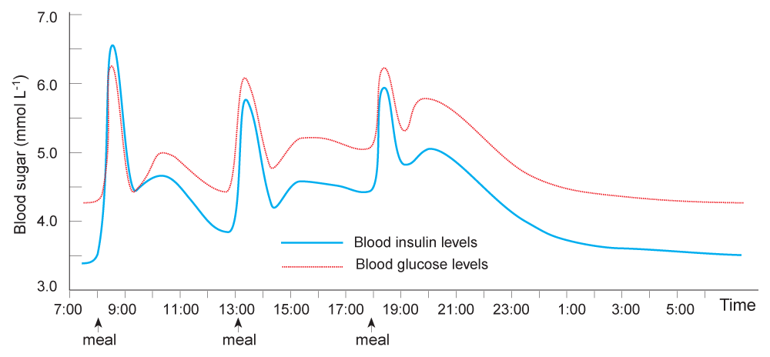
Blood Glucose vs Insulin
The graph below shows the changes in blood glucose and insulin levels over a 24 hour period, during which three meals are eaten.

Slide 11
Blood Glucose Regulation
The body’s extra energy is stored as glycogen or fat, and mobilized to meet energy needs as required.
The liver is pivotal in these carbohydrate conversions.
One of the consequences of a disruption to this system is the disease diabetes mellitus.
Beta cells
Alpha cells
Stimulates β cells to secrete insulin
Stimulates α cells to secrete glucagon
Insulin promotes uptake of glucose by cells and conversion of glucose to stored glycogen or fat in the liver.
Normal blood glucose (BG) level
3.9 - 5.6 mmol L⁻¹
Glucagon stimulates breakdown of glycogen to glucose in the liver.
Uptake of glucose from blood
Release of glucose into the blood

Slide 12

Insulin Signaling Pathway
Insulin is a peptide hormone secreted by the pancreas. Its primary role is maintaining blood glucose homeostasis.
Insulin production is tightly regulated because over-or underproduction has serious physiological consequences (even death):
too little insulin results in elevated blood glucose levels (hyperglycemia).
too much insulin results in low blood glucose levels (hypoglycemia).
Outside of cell
α-subunits
β-subunits
Extracellular domain
Intracellular domain
Cell cytosol

Slide 13
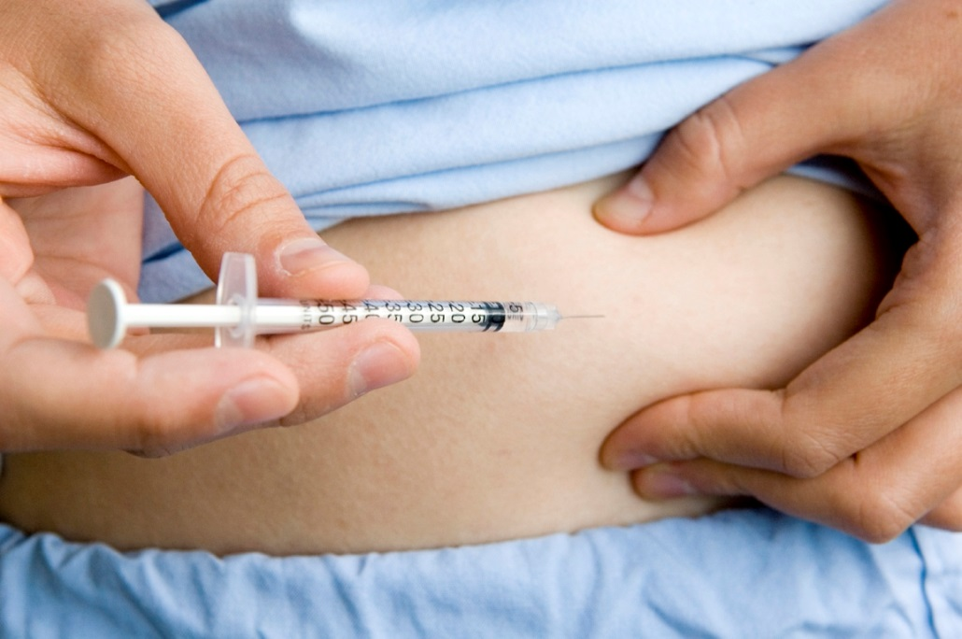
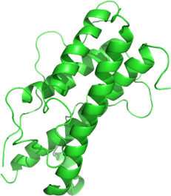
Symptoms of Disease
Symptoms of endocrine disorders include:
Loss of function or control.
The inability of the endocrine system to produce or respond to the correct hormonal signals can result in the loss of the body’s ability to regulate key aspects of metabolism (e.g. the loss of insulin production leads to an inability to control blood glucose levels).
Developmental failure.
Hormones can have large scale effects of the body. Examples include the over or under production of human growth hormone by the pituitary, resulting in excessive or insufficient growth of the body.
Insulin injection for type I diabetes
Istock
Growth hormone

Slide 14
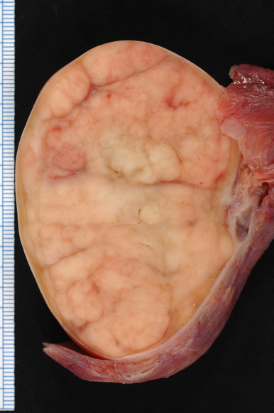
Diseases of the Endocrine System
Diseases of the endocrine system include:
Genetic diseases (e.g. type 1 diabetes)
Mutations in genes can lead to the faulty production of a hormone or its intermediate.
Cancers (e.g testicular cancer, right)
Autoimmune damage
Malfunction of the immune system can cause immune attacks of the endocrine glands, damaging them and resulting in disrupted hormone production (e.g. type 1 diabetes).
Dietary related diseases
Poor dietary choices in childhood can lead to adult onset diabetes (type 2 diabetes)
Cancer
Photo: Ed Uthman

Slide 15
Type 1 Diabetes Mellitus
Type I diabetes (also called insulin dependent diabetes mellitus) is the least common form of diabetes mellitus (about 10% of cases) and the most severe. About 1 in 1000 children develop type 1 diabetes by the age of 16.
It is a disease resulting from insufficient or no insulin production, usually due to the autoimmune destruction of the beta cells of the pancreatic islets.
The onset is sudden, often between the ages of 10 and 16 (hence its olden name, juvenile-onset diabetes).
There is a genetic component but a triggering factor, such as a viral infection, causes the disease to develop.
It is fatal unless treated with insulin.
Concentration of blood glucose after fasting blood glucose test
Condition | mg dL⁻¹
Normal | <99
Possible pre-diabetes | 99 - 126
Diabetes mellitus | >126
The simplest way to diagnosis diabetes by the fasting blood glucose test. After not eating for around 12 hours the concentration of glucose in the blood is measured. A positive result is a concentration above 126 mgdL⁻¹

Slide 16
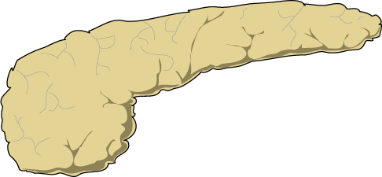
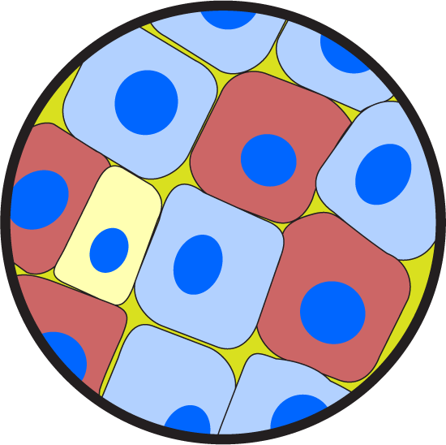
Type 1 Diabetes Mellitus
Endocrine region of a normal pancreas enlarged to show function of cell types
Pancreas
Alpha cells produce glucagon which promotes glucose release from the liver
Delta cells produce somatostatin which inhibits the release of growth hormone from the anterior pituitary
Beta cells produce insulin, the hormone responsible for cellular uptake of glucose. It is these cells that are destroyed in type 1 diabetes mellitus.

Slide 17

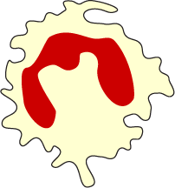

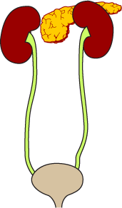
Symptoms of Type 1 Diabetes
Constant thirst to compensate for excessive urine production. (polydipsia). Increased hunger (polyphagia) and weight loss.
3
1
Without insulin, the body’s cells cannot take up glucose and lack an energy source for their metabolism.
4
Muscles: Inability to utilize glucose leads to weakness and fatigue.
2
Kidneys: volume of urine increases to clear the body of excess blood glucose (polyuria).
5
Fats are metabolized for energy leading to a fall in blood pH (ketosis). This is potentially fatal.
6
Bladder and urinogenital tract: High sugar levels in the blood and urine promote bacterial and fungal infections.
CA

Slide 18
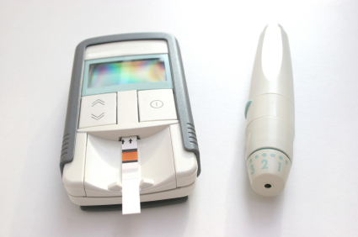
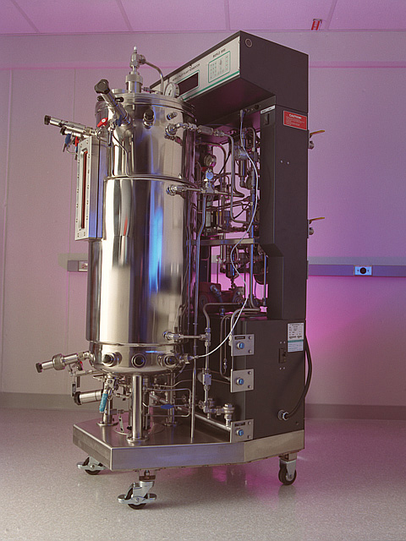
Treating Type 1 Diabetes
Present treatments for type 1 diabetes include:
Regular insulin injections combined with dietary management to keep blood sugar levels stable.
Blood glucose is monitored regularly with testing kits to guard against sudden falls in blood glucose (hypoglycemia).
Insulin was once extracted from dead animals.
Now, genetically engineered yeast or bacterial cells containing the gene for human insulin are grown in culture, providing abundant, low cost insulin, without the side effects associated with animal insulin.
Istock

Slide 19
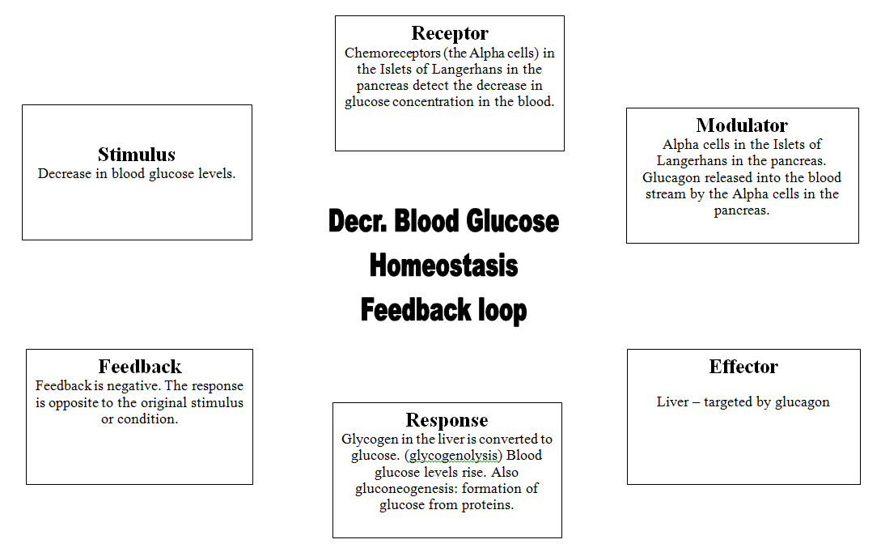
Blood glucose regulation

Slide 20
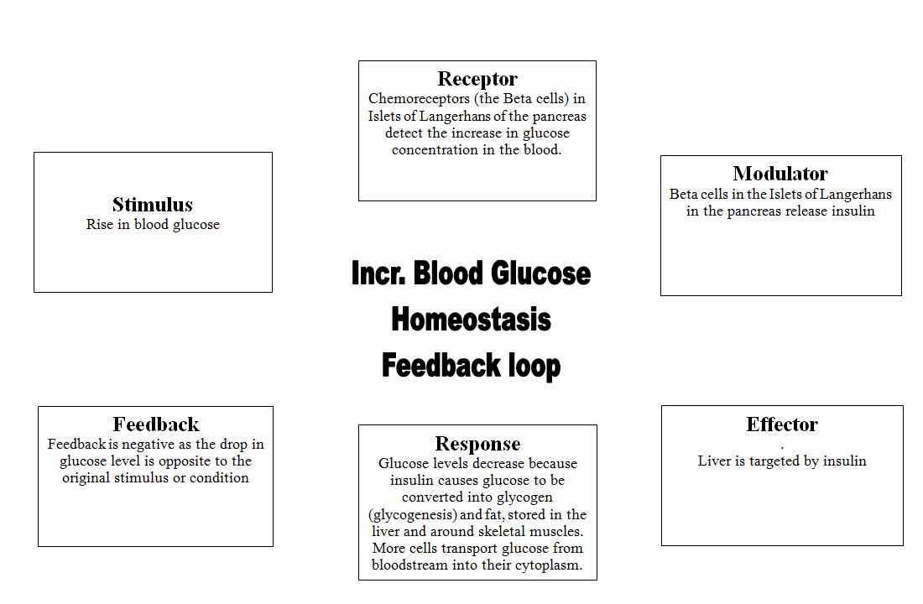
Blood glucose regulation

Slide 21
Gas concentration
All cells need continuous supply of oxygen for respiration.
All cells produce carbon dioxide as a waste product through respiration
The respiratory system takes in oxygen and excretes carbon dioxide
The circulatory system carries oxygen from lungs to cells and takes away carbon dioxide from cells to lungs.

Slide 22
Receptors
Peripheral chemoreceptors in aortic /carotid bodies
Central chemoreceptors in medulla oblongata
Respiratory centre located in medulla oblongata
Large decrease (mostly not involved) in oxygen stimulates receptors.
Increase in carbon dioxide concentration, increases hydrogen ion (decreases pH) concentration stimulates receptors.
All factors interact to regulate breathing rate

Slide 23
Effectors
Diaphragm , intercostal muscles require stimulation to contract and move air in and out of lungs
Voluntary control of breathing is possible eg. speech, hyperventilation
Bypasses respiratory centre in medulla oblongata and uses cerebral cortex.

Slide 24
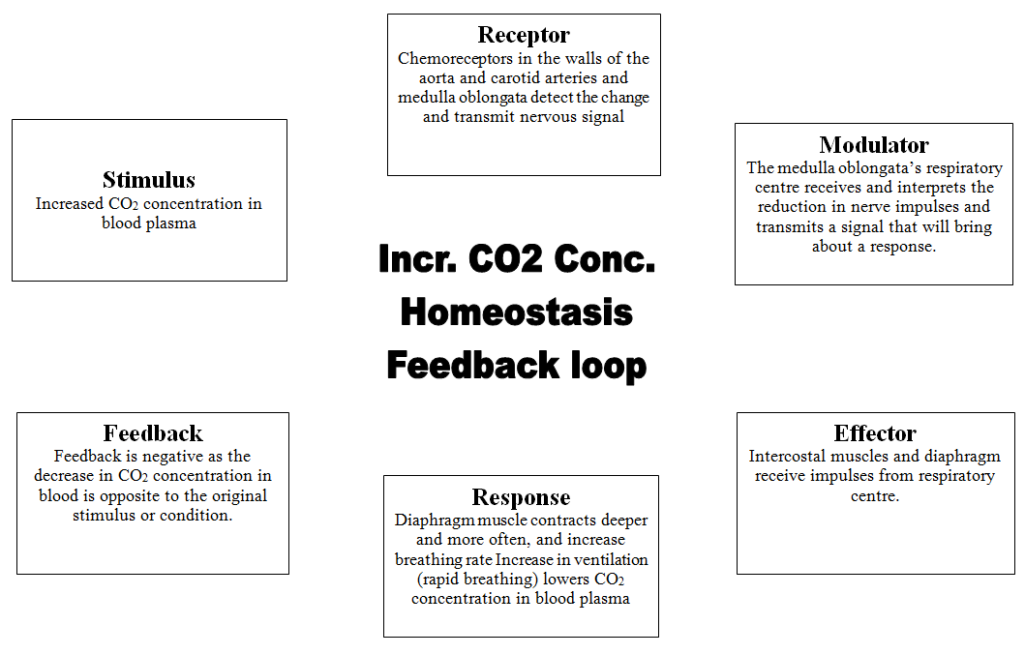
Gas concentration

Slide 25
Heart rate/Blood pressure
Heart rate=number of times the heart beats per minute.
SA node and AV node are specialised cells that stimulate muscle contraction.
Influenced by autonomic nervous system where neurons carry impulses to nodes/atria.
Medulla oblongata is cardiac centre
During exercise, sympathetic activity increases heart rate.
Parasympathetic system decreases activity in time of rest
Blood pressure=force with which the blood pushes on blood vessel walls.
Blood pressure affected by cardiac output/diameter of blood vessels.
Increases in heart rate/increases blood pressure etc.

Slide 26

Heart rate

Slide 27

Heart rate

Slide 28
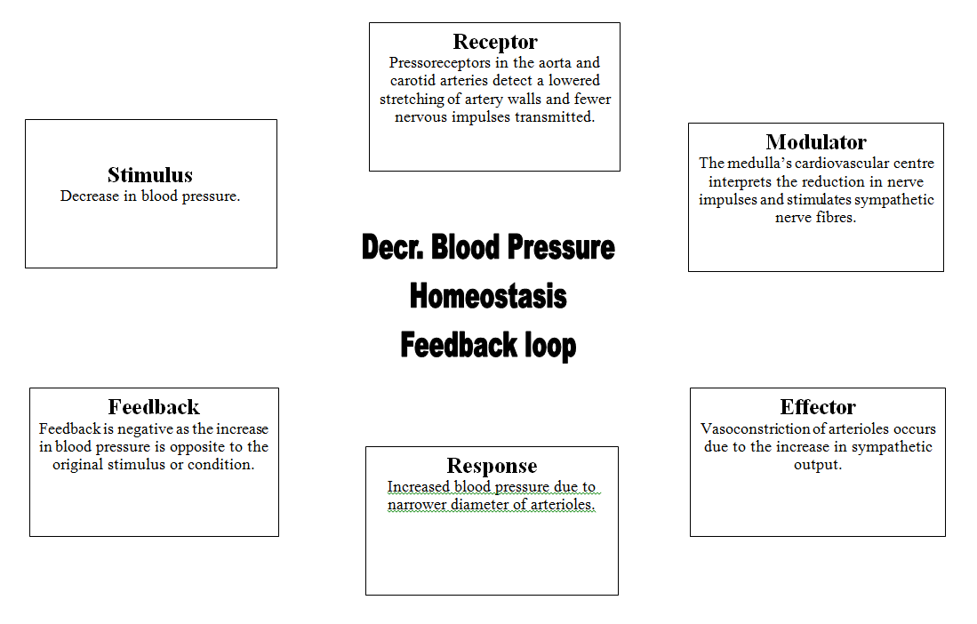
Blood pressure

Slide 29
